Slide 1
A Visual Analytics Process for Exploring Risk and Vulnerability in International Food Trade Networks
Travis Seville
Committee: Ross Maciejewski (Chair),
I-Han Hsiao, Shade Shutters

Slide 2
Outline
Problem
Current visualizations
Comparisons
Limitations
Improvements
Developed a visual analytics system for exploring second-order effects of climate change under the lens of global trade
Modeling of international food trade network (IFTN)
Visualizations
Case studies demonstrating the use of the system

Slide 3
Outline
Problem
What
Why solve?
Current visualizations
Comparisons
Limitations
Improvements
Developed a visual analytics system for exploring second-order effects of climate change under the lens of global trade
Modeling of international food trade network (IFTN)
Visualizations
Case studies demonstrating the use of the system

Slide 4
Problem: What?
Increase in globalization leads to an increase in utilization of the food trade network to feed people, countries are becoming more import-dependent
Climate events are no longer localized and these regional events may have global effects on food security^{[1]}
There is limited research considering second-order effects of climate events to the food trade network
[1] Sternberg, T., “Chinese drought, bread and the Arab Spring”, Applied Geography 34, 519–524 (2012).

Slide 5
Problem: What?
Increase in globalization leads to an increase in utilization of the food trade network to feed people, countries are becoming more import-dependent
Climate events are no longer localized and these regional events may have global effects on food security^{[1]}
There is limited research considering second-order effects of climate events to the food trade network
[1] Sternberg, T., “Chinese drought, bread and the Arab Spring”, Applied Geography 34, 519–524 (2012).

Slide 6
Problem: What?
Increase in globalization leads to an increase in utilization of the food trade network to feed people, countries are becoming more import-dependent
Climate events are no longer localized and these regional events may have global effects on food security^{[1]}
There is limited research considering second-order effects of climate events to the food trade network
[1] Sternberg, T., “Chinese drought, bread and the Arab Spring”, Applied Geography 34, 519–524 (2012).

Slide 7

What is a Second-Order Effect?
Country A exports to Country B
Trade link X
Country B exports to Country C
Trade link Y
A
B
C
X
Y

Slide 8
What is a Second-Order Effect?
What happens when a climate event impacts Country A?
Trade link X and Y are both affected!
Drought
A
B
C
X
Y

Slide 9
Problem: Why?
This tool can help direct international aid
A drought is happening in a specific country
We can help the affected country
We may need to shift some of that aid to a country downstream
Is there anything we can do to an identified vulnerable country
Stage food stores
Bread vouchers
Policy making decisions
Contingency planning
Food store quantities

Slide 10
Problem: Why?
This tool can help direct international aid
A drought is happening in a specific country
We can help the affected country
We may need to shift some of that aid to a country downstream
Is there anything we can do to an identified vulnerable country
Stage food stores
Bread vouchers
Policy making decisions
Contingency planning
Food store quantities

Slide 11
Problem: Why?
This tool can help direct international aid
A drought is happening in a specific country
We can help the affected country
We may need to shift some of that aid to a country downstream
Is there anything we can do to an identified vulnerable country
Stage food stores
Bread vouchers
Policy making decisions
Contingency planning
Food store quantities

Slide 12
Problem: Why?
This tool can help direct international aid
A drought is happening in a specific country
We can help the affected country
We may need to shift some of that aid to a country downstream
Is there anything we can do to an identified vulnerable country
Stage food stores
Bread vouchers
Policy making decisions
Contingency planning
Food store quantities

Slide 13
Outline
Problem
Current visualizations
Comparisons
Limitations
Improvements
Developed a visual analytics system for exploring second-order effects of climate change under the lens of global trade
Modeling of international food trade network (IFTN)
Visualizations
Case studies demonstrating the use of the system

Slide 14
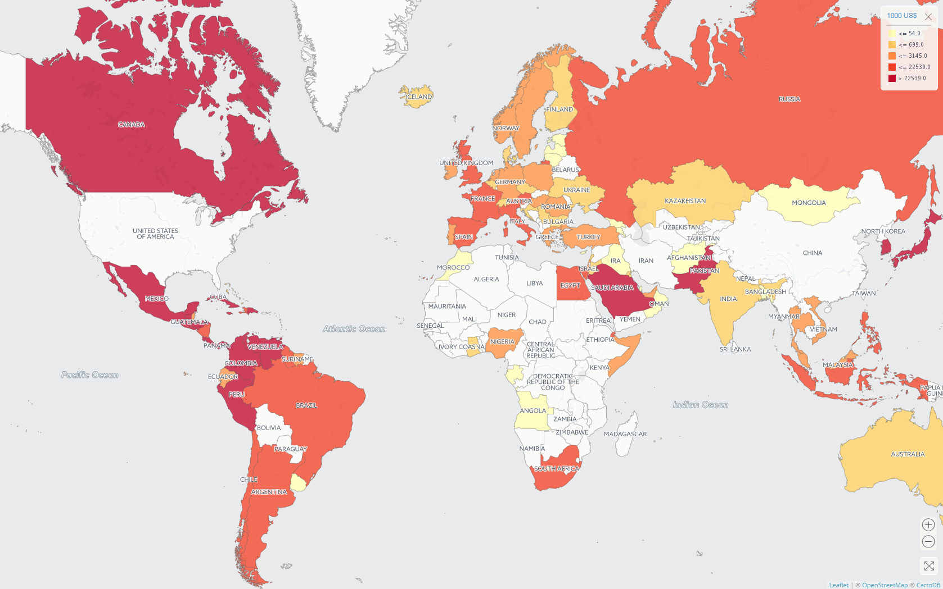
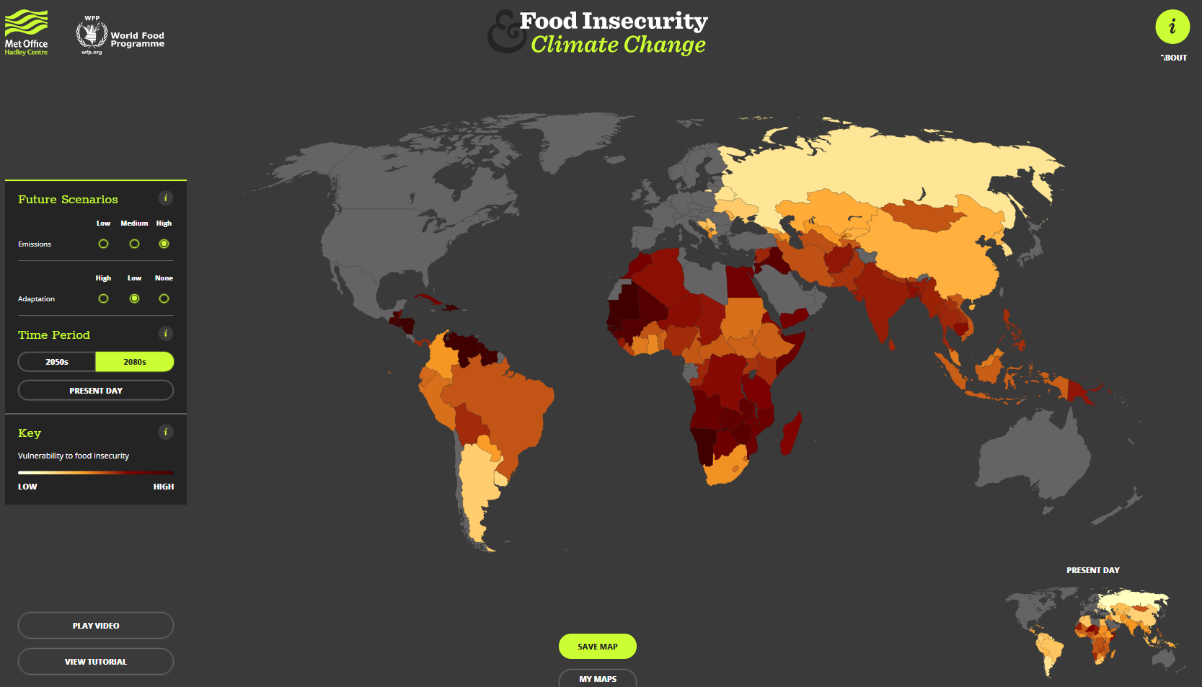
Current Visualizations
Met Office Food Insecurity & Climate Change (www.metoffice.gov.uk/food-insecurity-index)
FAOSTAT Data Visualization
(www.fao.org/faostat/en/#data/TM/visualize)
Notes:
Notice they are both choropleths, it’s hard to visualize a network like this.

Slide 15
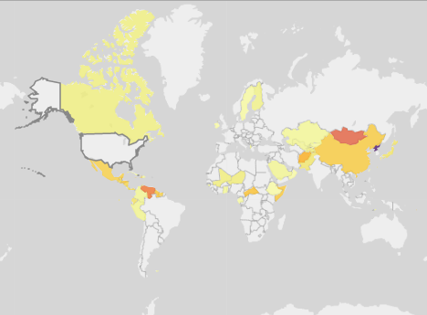
Current Visualizations: Comparisons
Met Office Food Insecurity & Climate Change (www.metoffice.gov.uk/food-insecurity-index)
My System
Notes:
Choropleth makes sense as a representation of vulnerability:
Left: Global scale
Right: Response to climate event

Slide 16
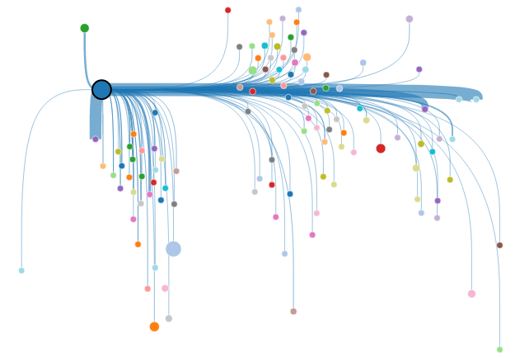
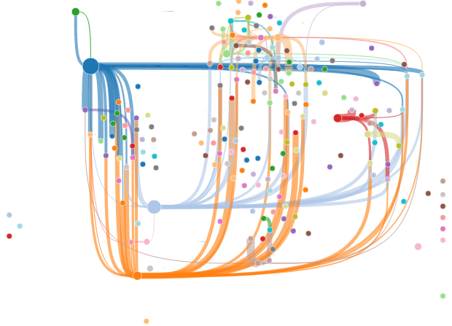
Current Visualizations: Comparisons
FAOSTAT Data Visualization
(www.fao.org/faostat/en/#data/TM/visualize)
My System
From here it looks like Canada and Mexico both import about the same
In reality Mexico imported $1.85 billion and Canada $281 million
Notes:
FAOSTAT Viz
Again choropleth, may not be best representation a trade network
First filtered to show the same information
Deceiving visualization
My system allows to visualize the whole network

Slide 17
Current Visualizations: Limitations
The food trade network and food security indices are not modeled together
Not a visual analytic system!
No analysis
Notes:
Main limitation is the lack of the two being modeled together

Slide 18
Current Visualizations: Improvements
The food trade network and food security indices are not modeled together
Not a visual analytic system!
No analysis

Slide 19
Outline
Problem
Current visualizations
Comparisons
Limitations
Improvements
Developed a visual analytics system for exploring second-order effects of climate change under the lens of global trade
Modeling of international food trade network (IFTN)
Visualizations
Case studies demonstrating the use of the system

Slide 20
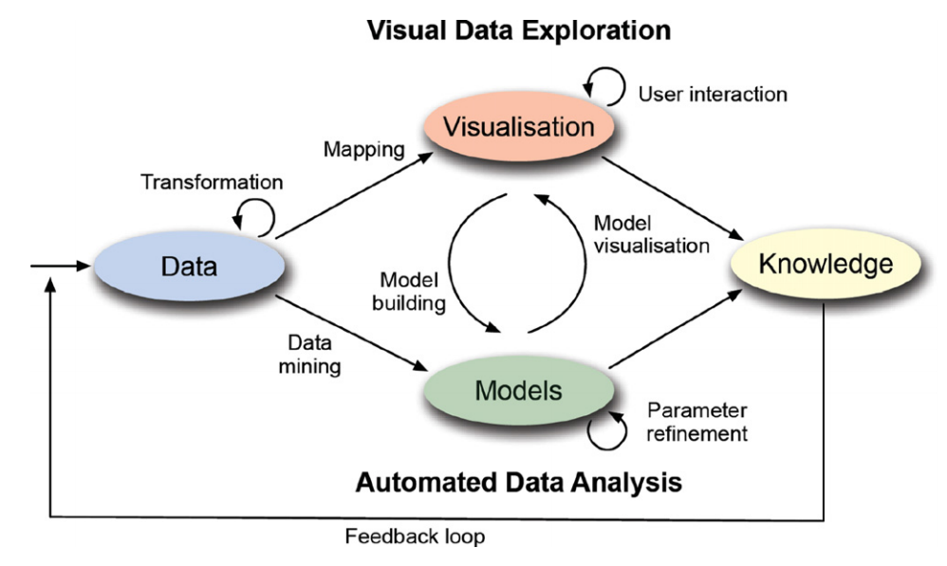
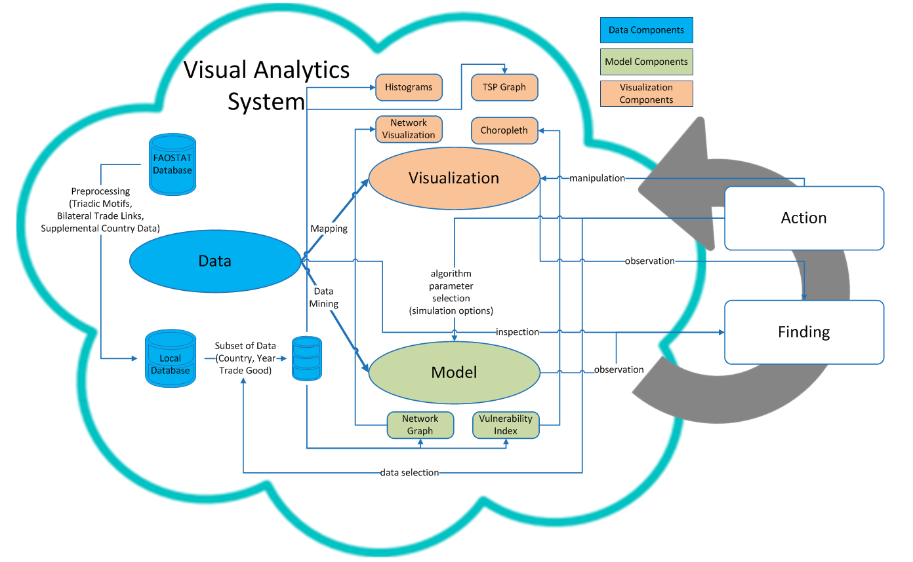
Visual Analytics
Typical Visual Analytics System
Keim et al. (2011)
My Visual Analytics System
motivated by Sacha et al. (2014)
Keim, D., J. Kohlhammer, M. Pohl, G. Santucci and G. Andrienko, “Solving problems with visual analytics”, Procedia Computer Science 7, 117–120 (2011).
Sacha, D., A. Stoffel, F. Stoffel, B. C. Kwon, G. Ellis and D. A. Keim, “Knowledge generation model for visual analytics”, IEEE transactions on visualization and computer graphics 20, 12, 1604–1613 (2014).

Slide 21
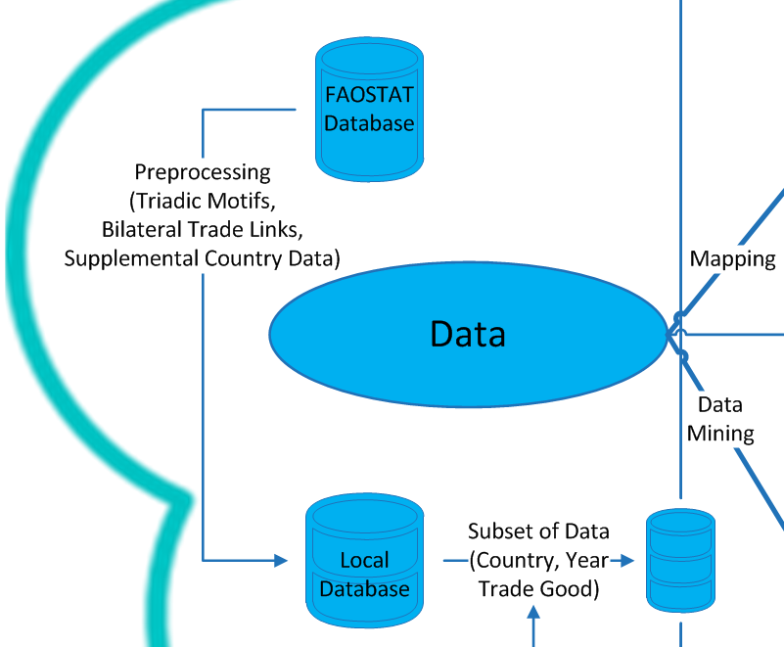
Visual Analytics
Data
My Visual Analytics System
FAOSTAT database from the United Nations
Preprocessing
Triads
Bilateral trade links
Selection

Slide 22
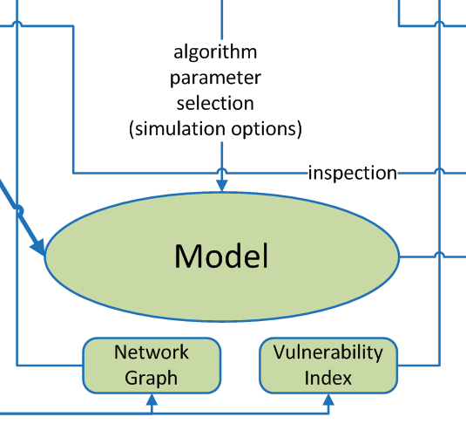
Visual Analytics
Model
My Visual Analytics System
Modeled as a weighted directed graph
Nodes are counties
Edges are trade links
Direction indicates the direction of trade (from exporter to importer)
Edges are weighted
Value of this single trade link in relation to the country’s entire trade portfolio
Why? High dependency on a single staple crop for supply of calories and a high dependency on imports indicates a higher risk^{[1]}
[1] d’Amour, C. B., L. Wenz, M. Kalkuhl, J. C. Steckel and F. Creutzig, “Teleconnected food supply shocks”, Environmental Research Letters 11, 3, 035007 (2016).

Slide 23
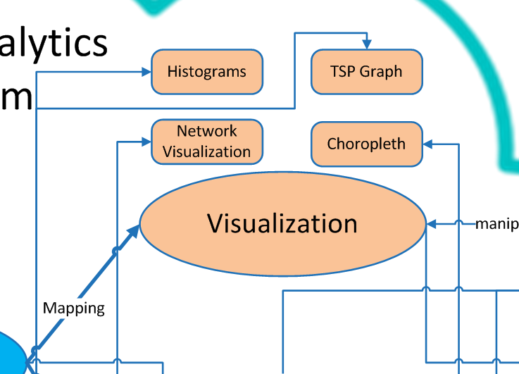
Visual Analytics
Visualizations
My Visual Analytics System
Histograms visualize high-risk links
Network visualization (node-link graph) shows topology of links
Choropleth is indication of vulnerability
Triad Significance Profiles graph highlights distributions of triads

Slide 24
Outline
Problem
Current visualizations
Comparisons
Limitations
Improvements
Developed a visual analytics system for exploring second-order effects of climate change under the lens of global trade
Modeling of international food trade network (IFTN)
Visualizations
Case studies demonstrating the use of the system

Slide 25
Case Studies
2011 Chinese drought
Simulated US Climate Event

Slide 26
Case Studies
2011 Chinese drought
Simulated US Climate Event
Notes:
The first is the 2011 Chinese drought, which shows some of the vulnerabilty

Slide 27
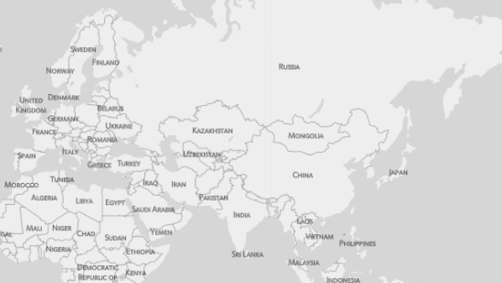
Case Study: 2011 Chinese Drought
A regional climate event in potentially had a global effect on food security
The recent Arab Spring has been linked to this regional drought^{[1]}
How does a drought in China affecting wheat production cause political instability in Egypt?
China doesn’t export wheat to Egypt
?
[1] Sternberg, T., “Chinese drought, bread and the Arab Spring”, Applied Geography 34, 519–524 (2012).

Slide 28
Case Study: 2011 Chinese Drought
Food trade network can affected by reduced production or export bans
Large increase in Chinese wheat imports drives prices to new record highs
Russia continues existing export bans on wheat
From the previous year’s poor harvest due to drought^{[1]}
?
[1] Fellmann, T., S. H´elaine and O. Nekhay, “Harvest failures, temporary export restrictions and global food security: the example of limited grain exports from Russia, Ukraine and Kazakhstan”, Food Security 6, 5, 727–742 (2014).

Slide 29
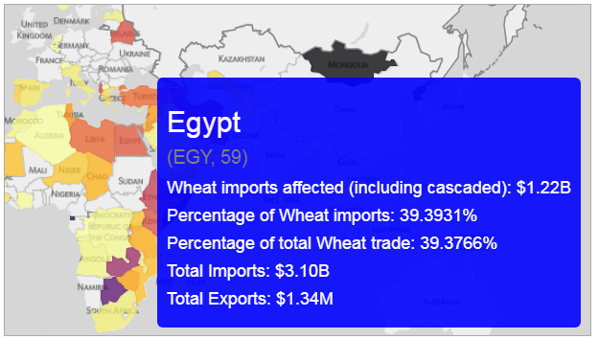
Case Study: 2011 Chinese Drought
Export ban in Russia led to supply shocks to Egypt
Using this system we are able to see the effects of the simulation

Slide 30
Case Studies
2011 Chinese drought
Simulated US Climate Event

Slide 31
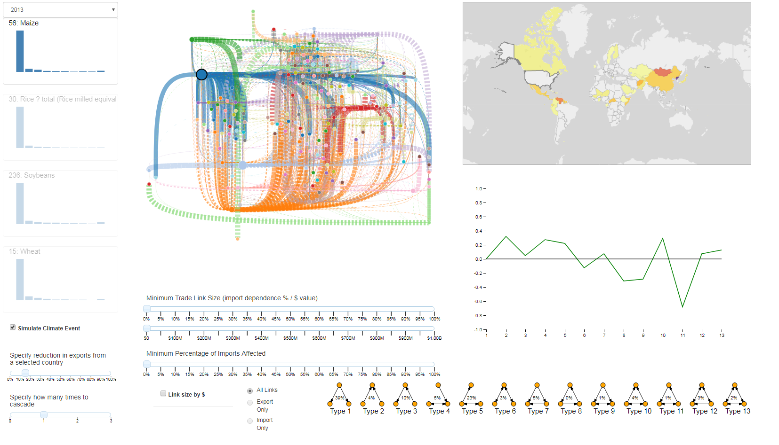
Case Study: Simulated US Climate Event
To highlight the cascading effects, we simulate a climate event in the United States, resulting in a 15% reduction of corn exports from the United States
Very busy network graph

Slide 32
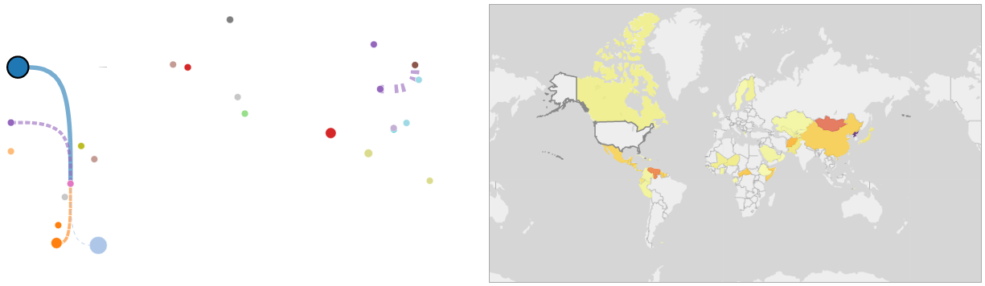
Case Study: Simulated US Climate Event
Add filtering to the network graph
Minimum Trade Link Size ($25 million)
Minimum Percentage of Imports Affected (30%)
Identify two countries of interest: Venezuela and North Korea
(Mongolia is red too, but they only import $109k)
United States
North Korea
Venezuela

Slide 33
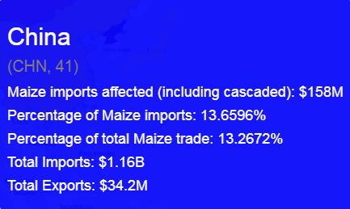
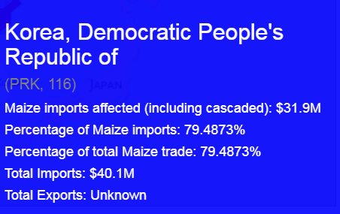
Case Study: Simulated US Climate Event
Results:
North Korea has no direct link from the US yet it has lost ~79% of its corn imports
The reduction in imports to China is cascaded to North Korea
Note: There is
No direct trade link!

Slide 34
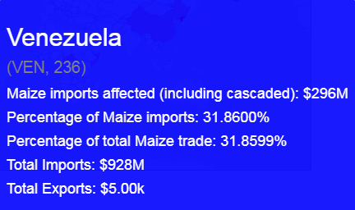
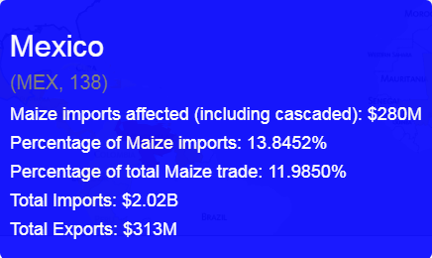
Case Study: Simulated US Climate Event
Results:
Venezuela has lost ~32% of its corn imports from a 15% US export reduction
The reduction in imports to Mexico is cascaded to Mexico
Note: US to Venezuela trade link is only $55 million

Slide 35
Case Study: Simulated US Climate Event
Cascaded or second-order effects
The US is a large exporter of corn, but are there any middle-men
Triad types 3, 4 & 7 account for around 20% of triads, indicating this paradigm exists
Triad distributions for four staple crops in the year 2013

Slide 36
Conclusion

